Slide 1
yMedia- VIDEO STREAMING AND SHARING PLATFORM

Slide 2
Strategic Vision and Core Objectives
project outlines four primary objectives that form the foundation of its development mandate. These are: 1.Providing a progressive web application (PWA) with offline capabilities.
2. Ensuring seamless video upload and streaming through cloud storage integration. 3. Offering an interface supporting engagement features such as likes, comments, and sharing. 4. Enabling users to manage their content through a personalized control panel.

Slide 3
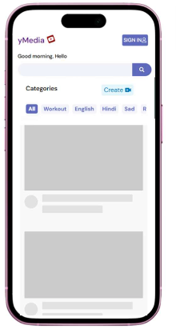
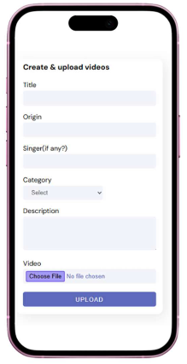
BASIc Ui & theme

Slide 4
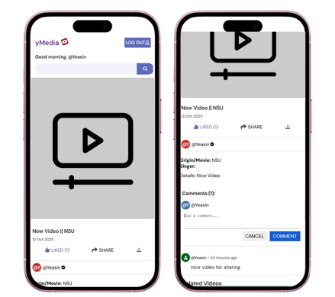
Functional Specification
Authentication Module
Content Management
User Interaction
User Interface & Experience
Progressive Web Application Features

Slide 5
System Architecture
Frontend HTML, CSS, JavaScript, ReactJS,
Backend Node.js, Express.js, RESTful API Encourage questions and provide thoughtful responses to enhance audience participation
Database MongoDB
Storage Firebase
Additional Dependencies Authentication libraries, Cloud storage SDKs

Slide 6
Thank you
@yMedia
Md Yeasin Hossain
Pallab Biswas
Antora Labiba

